Slide 1
Weapon Detection using Artificial Intelligence and Deep Learning for Security Applications Levels

Slide 2
About us!
Group Members name :
Ajay Das K, Muhammed Safeer T, Najmudheen Kp,fathima C
Register Number:
CCV19CS002, CCV19CS016, CCV19CS018, CCV19CS006
Class :
S6 CSE
Area of seminar:
Ai Vision
Guide name :
Mrs. Sruthy
(Assistant Professor (CSE Dept) MGM College of Engineering )
Date Of Submission :14/06/2022

Slide 3
PROJECT PRESENTATION
Weapon Detection using Artificial Intelligence and Deep Learning for Security Applications Levels
PART 3 (100%)
WEAPON DETECTING DRONE WITH OBJECT DETECTION
PART ONE(50%)
PART TWO(80%)
PART ONE CONSIST OF
A MOVING ROVER DRONE
PART TWO CONSIST OF IMPLIMENTATION OF OBJECT DETECTION

Slide 4
01
PART ONE
THE 50% OUTCOME THE MOVING DRONE

Slide 5
TABLE OF CONTENTS
01
02
03
04
THE INDRODUCTION
THE PROPOSED SYSTEM
MODULES USED
RESULT
05
PROJECT
STATUS
06
CONCLUSION

Slide 6
01
THE INDRODUCTION

Slide 7
As Per Shown In Datagram Our Team Desided To Partition The Project.
The First Review Contain The 50 % Outcome Which Include A Rover Drone Controlled By A Smartphone Application.
The Rover Drone Is Contain Motor& Wheels,micro Controller,motor Controling Unit ,Recever And Transmitter,powe Unit,application&smart Phone .
The Implimentation Of This Rover Drone Was Very Economical And Simple In Nature.

Slide 8
02
THE PROPOSED SYSTEM

Slide 9
THE PROPOSED SYSTEM
1.Motor& Wheels.
2.Micro Controller
3. Motor Controling Unit
4. Recever And Transmitter
5.Powe Unit
6.Application&smart Phone

Slide 10
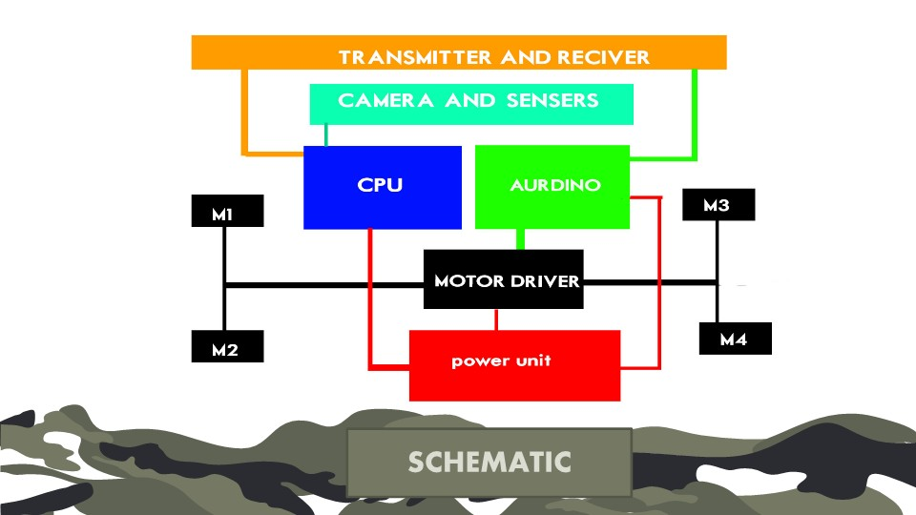
CBASIC DIAGRAM

Slide 11
03
MODULES USED

Slide 12
MODULES USED
,
Acrylic Sheets
Nut and bolts
3d printed wheels
Gearmotor
L298n motor driver
Aurdino board
Hc05 blue thooth module
Led lights
Wires
Li ion battary with bms system

Slide 13
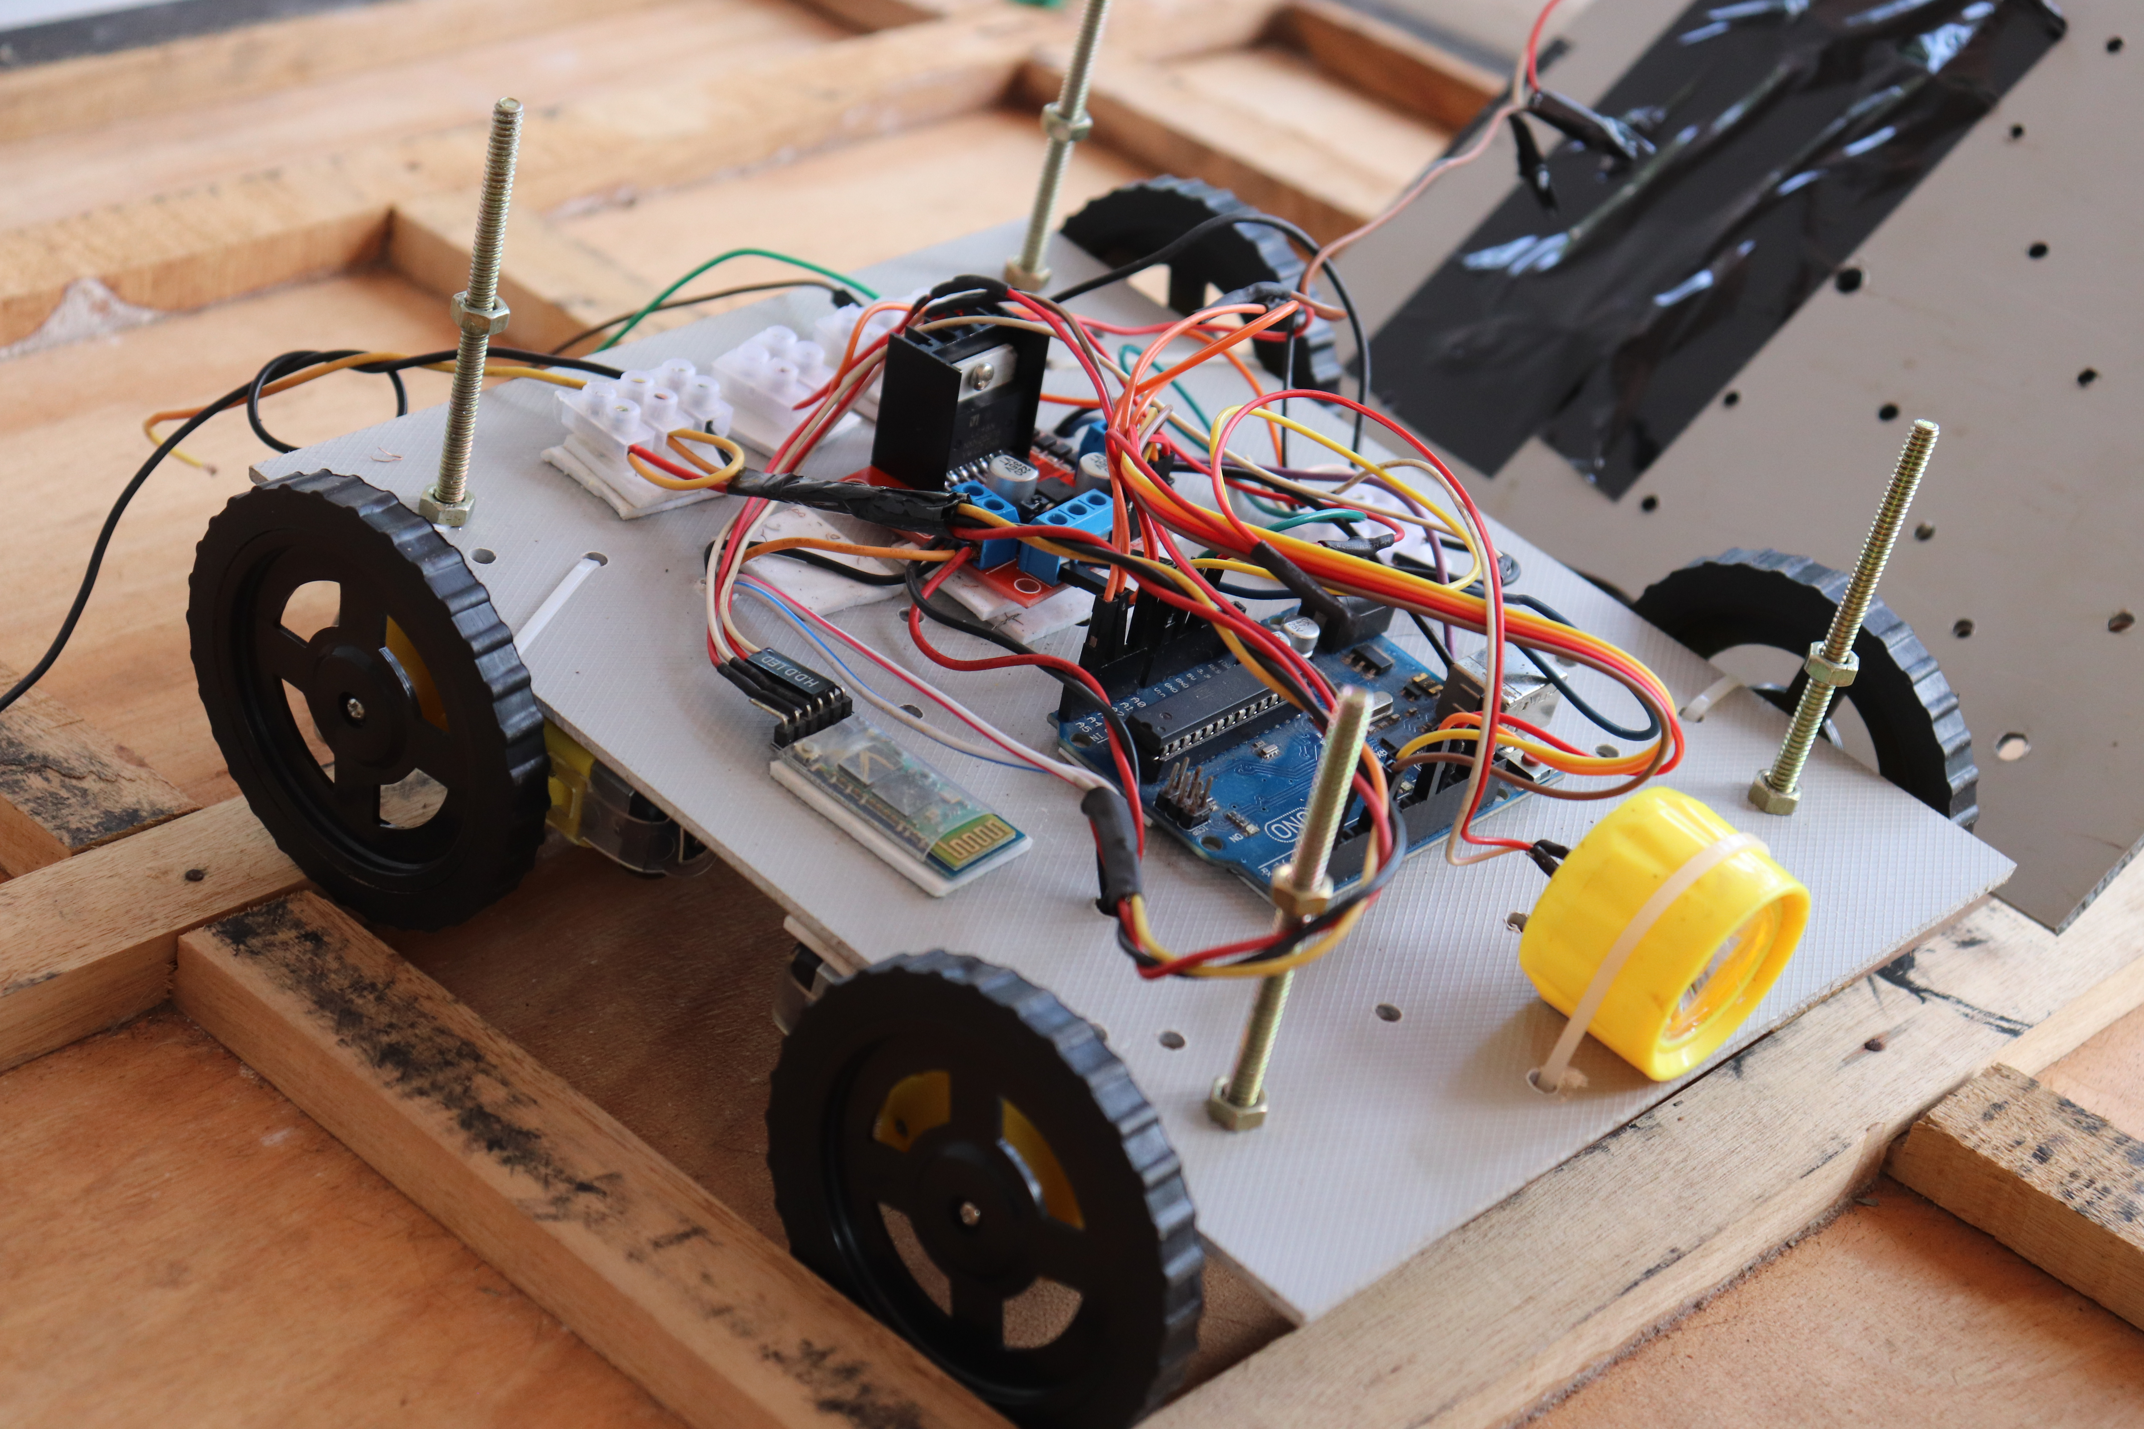
L298N MOTOR DRIVER
WIRES AND CONNECTORS
AURDINO BORD
HC 5 BLUETHOOTH MODULE
STEPPER MOTORS
LED LIGHTS
3D PRINTED WHEELS
ACRYLIC SHEETS

Slide 14

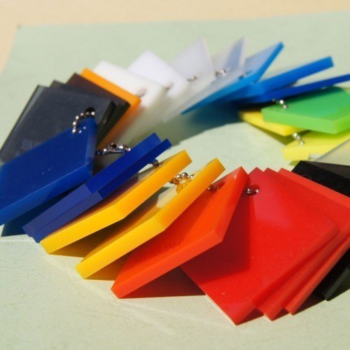
Acrylic Sheets
Acrylic is a transparent plastic material with outstanding strength, stiffness, and optical clarity
Acrylic sheet is easy to fabricate, bonds well with adhesives and solvents, and is easy to thermoform.
It has superior weathering properties compared to many other transparent plastics.

Slide 15
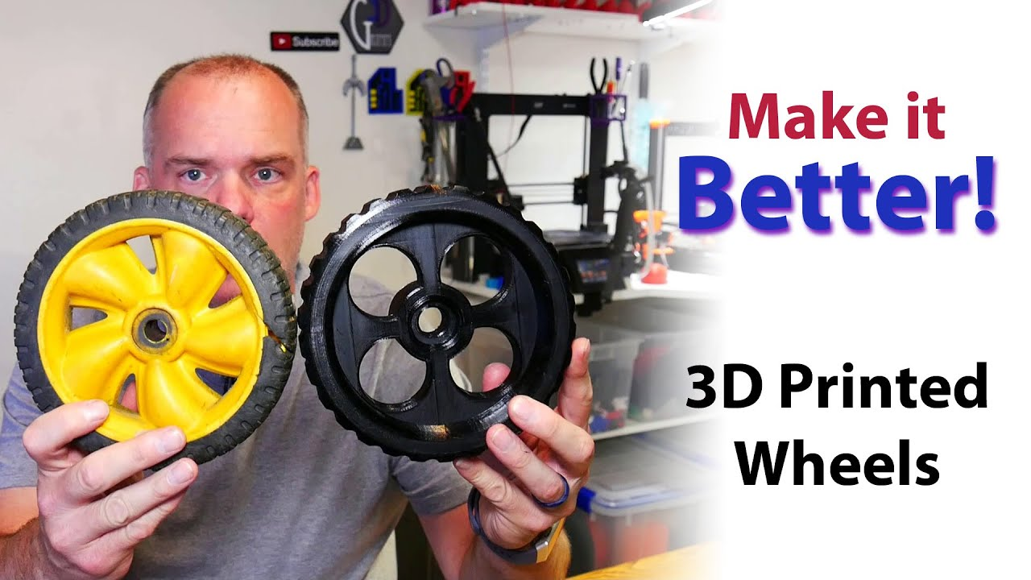
3d printed wheels
3D printing or additive manufacturing is the construction of a three-dimensional object from a CAD model or a digital 3D model.
It can be done in a variety of processes in which material is deposited, joined or solidified under computer control, with material being added together, typically layer by layer.
For cad www.thingivers
Video:www.youtube.com

Slide 16
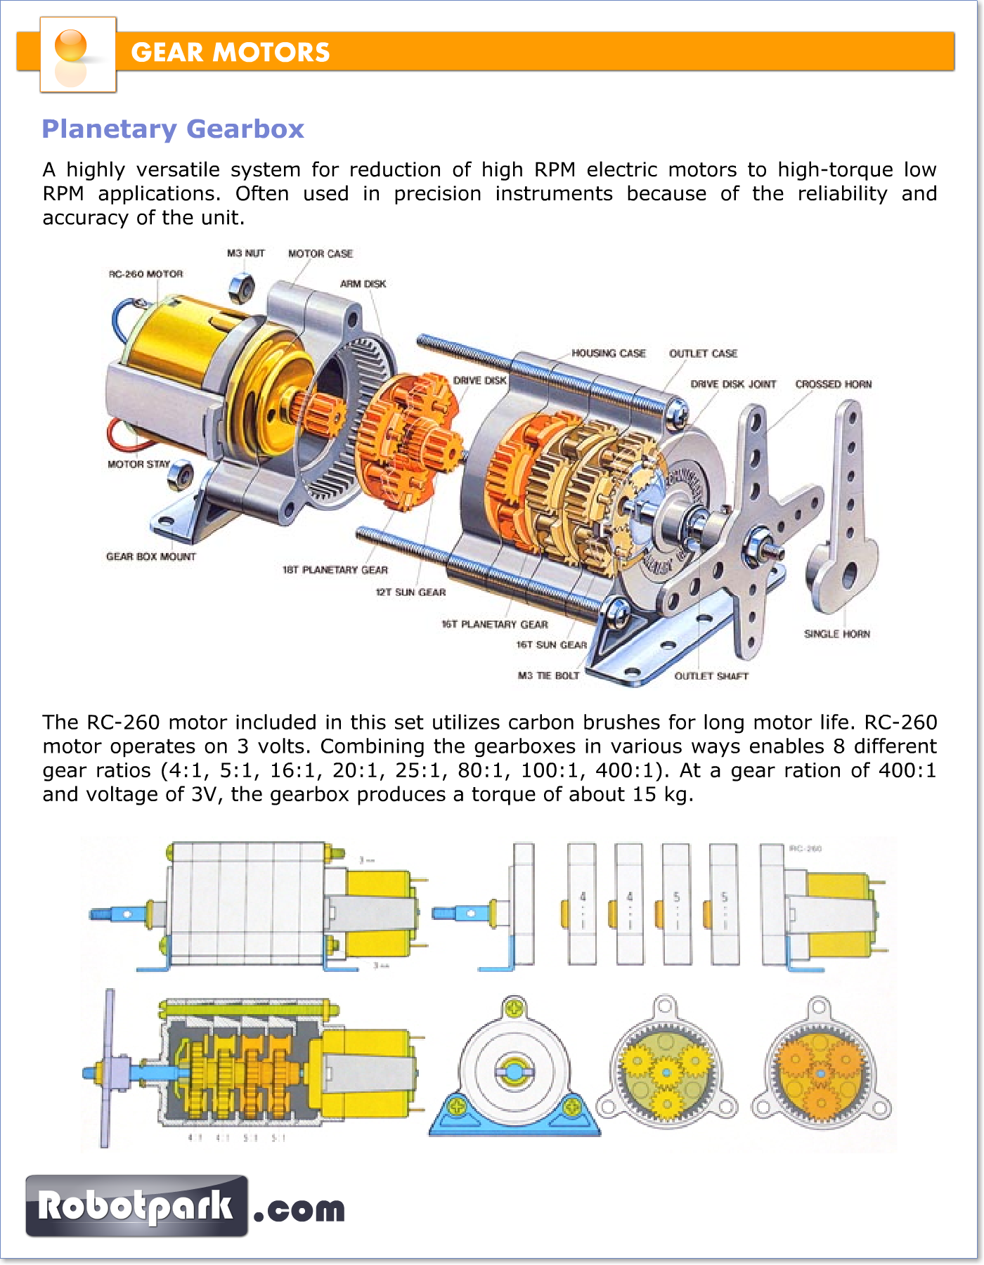
Gear motor
A gearmotor(or geared motor) is a small electric motor (AC induction, permanent magnet DC, or brushless DC) designed with an integral (non-separable) gear reducer (gearhead) attached
Working of gear motor:
You tube

Slide 17
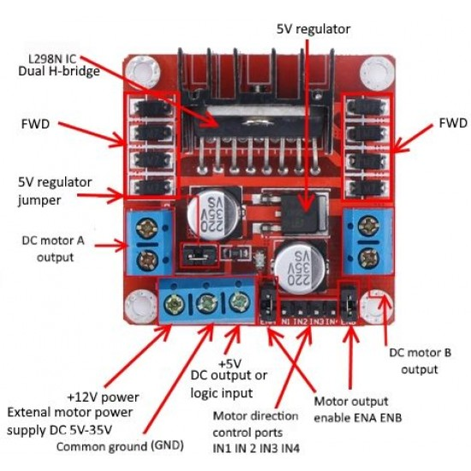
L298n motor driver
The L298N is a dual H-Bridge motor driver which allows speed and direction control of two DC motors at the same time.
The module can drive DC motors that have voltages between 5 and 35V, with a peak current up to 2A.
L298n motor driver working:You tube

Slide 18
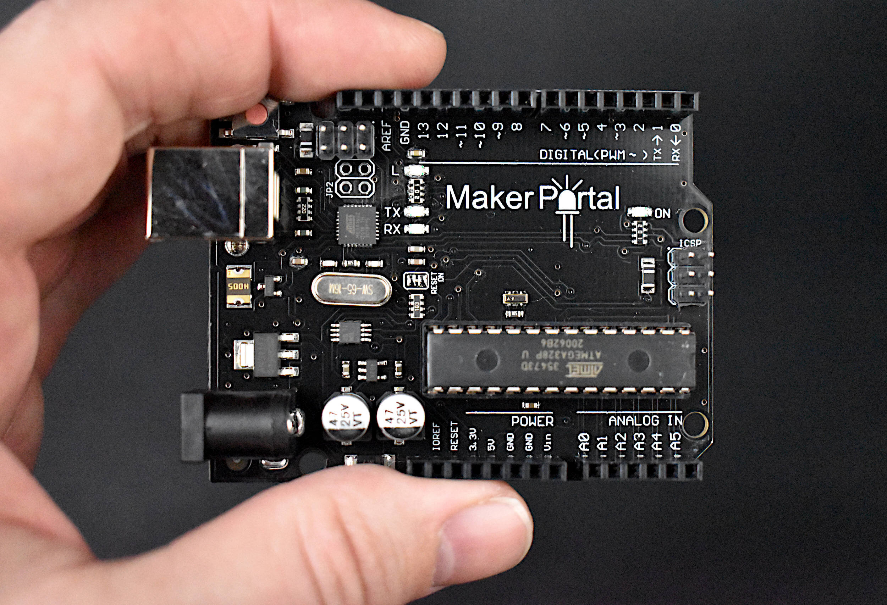
Aurdino board
Arduino is an open-source electronics platform based on easy-to-use hardware and software.
Arduino boards are able to read inputs - light on a sensor, a finger on a button, or a Twitter message - and turn it into an output - activating a motor, turning on an LED, publishing something online.

Slide 19
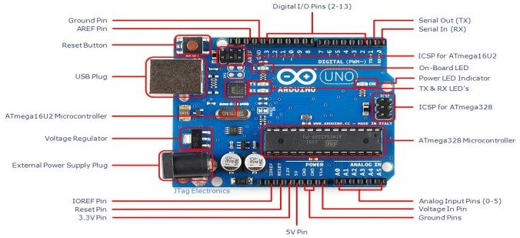
Componets in aurdino board

Slide 20
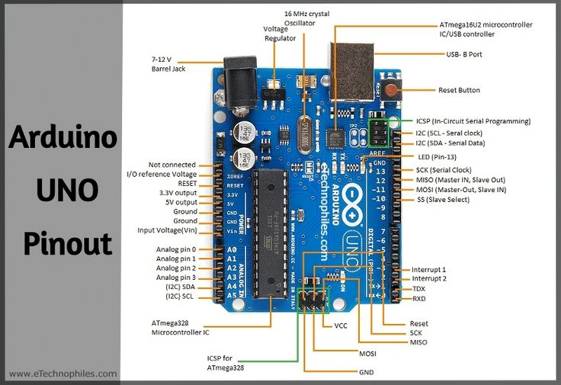
Pin diagram in aurdino board

Slide 21
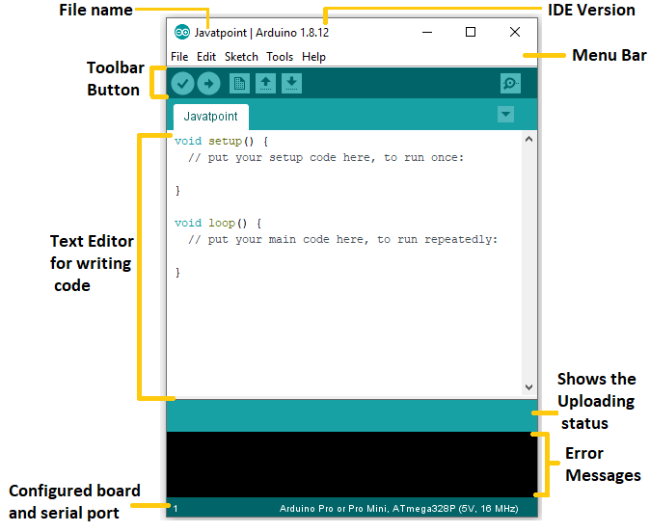
Arduino Software (IDE)
The Arduino Integrated Development Environment - or Arduino Software (IDE) - contains a text editor for writing code, a message area, a text console, a toolbar with buttons for common functions and a series of menus.
It connects to the Arduino hardware to upload programs and communicate with them.

Slide 22

Aurdino program
Arduino code is written in C++ with an addition of special methods and functions, which we’ll mention later on.
C++ is a human-readable programming language. When you create a ‘sketch’ (the name given to Arduino code files), it is processed and compiled to machine language.
The program code: Drone code

Slide 23
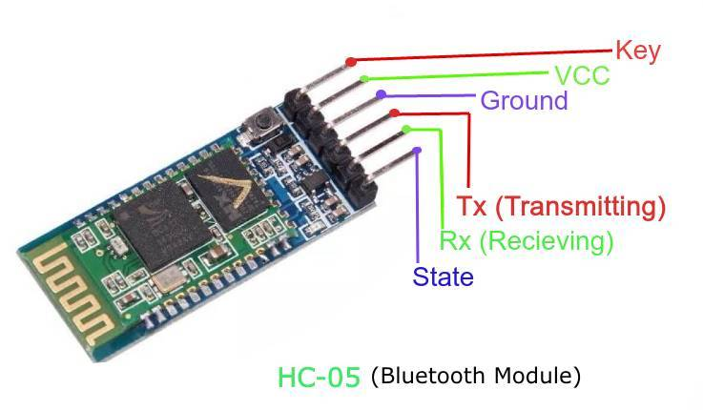
Hc05 blue thooth module
HC-05 Bluetooth Module is an easy to use Bluetooth SPP (Serial Port Protocol) module, designed for transparent wireless serial connection setup.
Its communication is via serial communication which makes an easy way to interface with controller or PC.

Slide 24
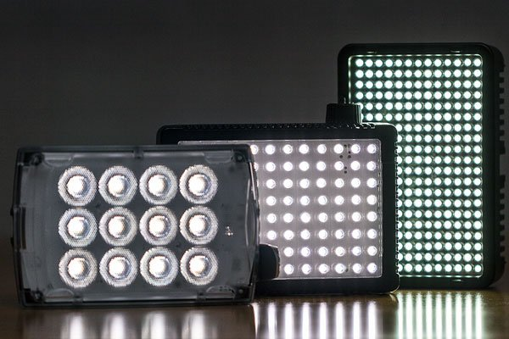
LED lights
The light-emitting diode (LED) is today's most energy-efficient and rapidly-developing lighting technology.
Quality LED light bulbs last longer, are more durable, and offer comparable or better light quality than other types of lighting.

Slide 25
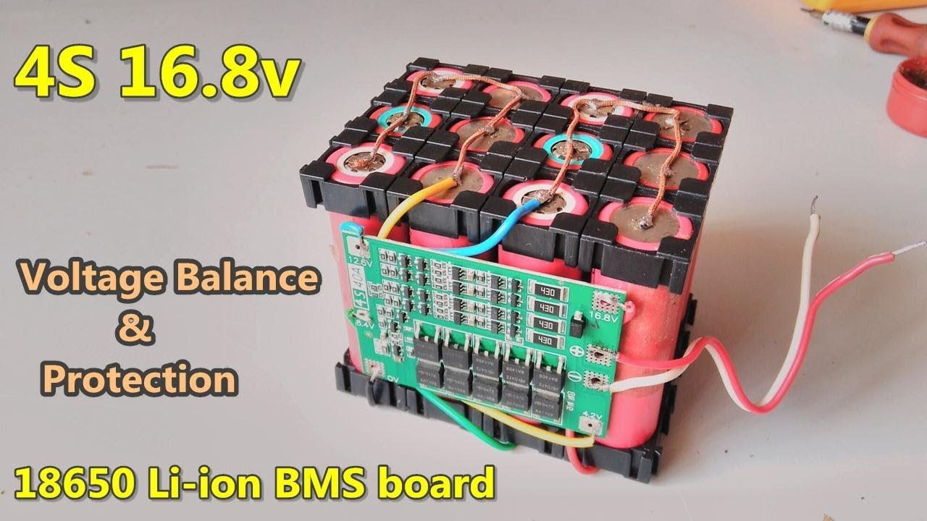
Li Ion Battary And Bms Circuit
A lithium-ion battery
Li-ion battery is a type of rechargeable battery composed of cells in which lithium ions move from the negative electrode through an electrolyte to the positive electrode during discharge and back when charging.
Li-ion battery BMS
A BMS (Battery Management System) is essential in a Lithium-Ion battery system. This device manages a real-time control of each battery cell, communicates with external devices, manages SOC calculation, measures temperature and voltage, etc.

Slide 26
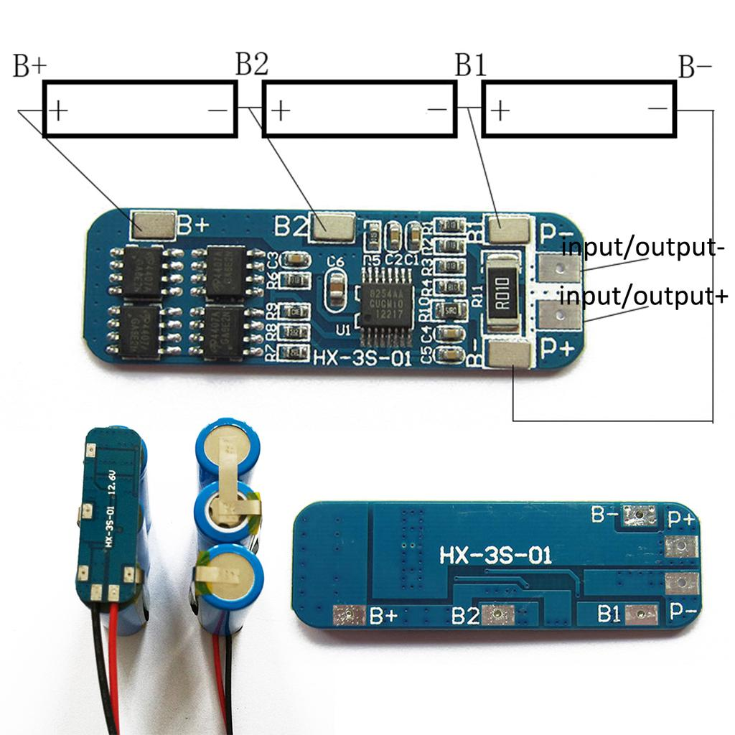
li ion battery bms 12v circuit

Slide 27

The rover controlling app Project Rower Rc
The app is builted for communicating the rc rover and smart bphone through the blue thooth medium
By the controller we can controll the rover speed ,movements and 4 additianal chanells used for distruction,lights,and signaling.

Slide 28
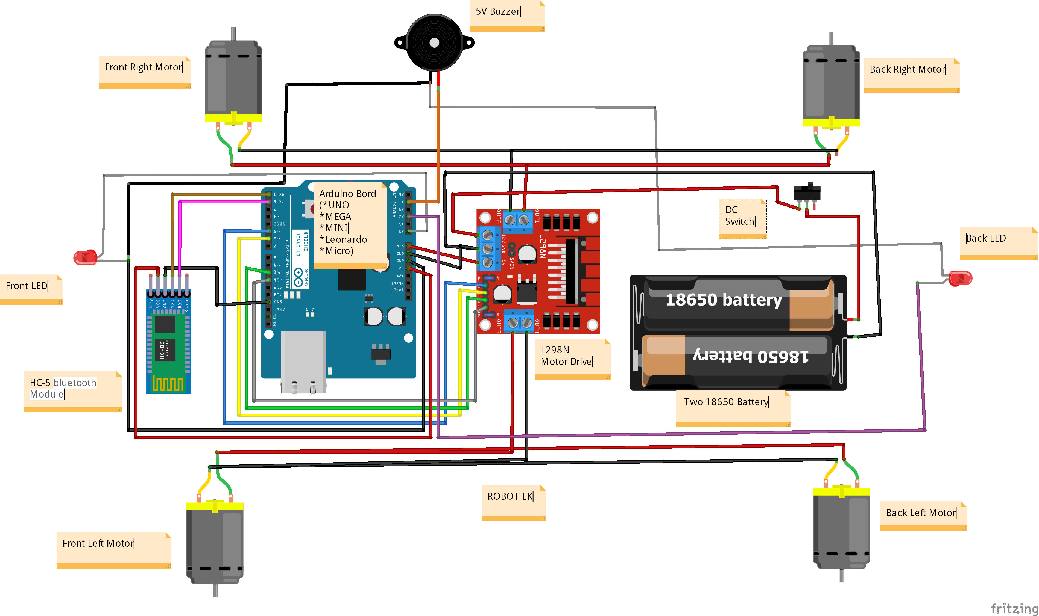
THE DRONE SCHEMATIC DIAGRAM

Slide 29
04
RESULT

Slide 30
THE DRONE

Slide 31
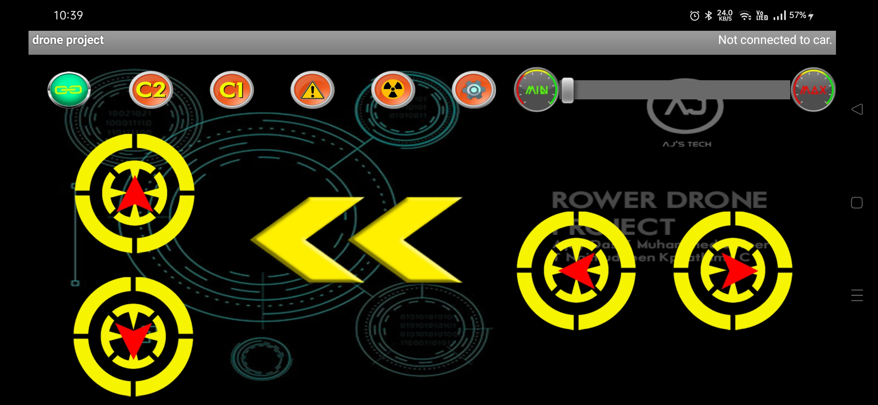
APPLICATION

Slide 32
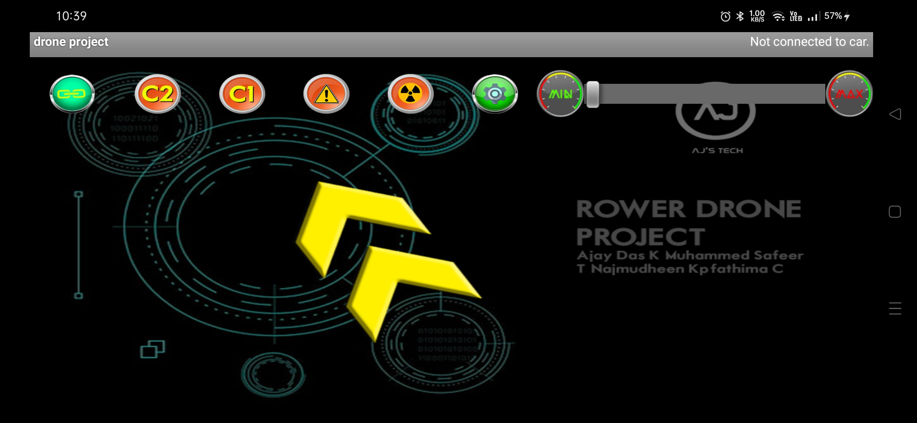
APPLICATION GESTURE CONTROLL

Slide 33
05
PROJECT STATUS

Slide 34
THE 50% OUTPUT IS COMPLETED SUCESSFULLY
THE ROVER DRONE IS COMPLETY IMPLIMENTED AND FULLFILLING ALL THE REQUIRMENTS

Slide 35
06
CONCLUSION

Slide 36
THE DRONE PROJECT EFFECTIVELY UTILIZES CPP CODIND SKILS AND ELECTRONIC KNOWLEDGE
SIMPLE ARCHITECTURE AND EFFECTIVE USE OF RESOURSES MKES THE IMPLIMENTATION MORE FASTER

Slide 37
THANKS!
Do you have any questions?

